Slide 1
Chapter 9 Introduction to PIC18 C Programming

Slide 2
Why program the PIC18 in C?
C programming is easier and less time consuming
C is easier to modify and update
Existing libraries available (e.g., delays)
C code is portable to other microcontroller with little or no modification
We will be using Microchip C18 compiler

Slide 3
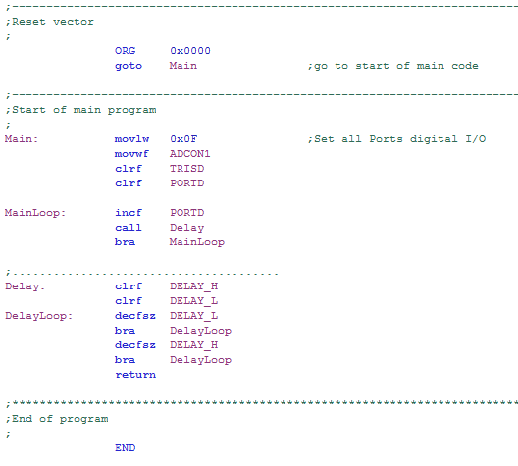
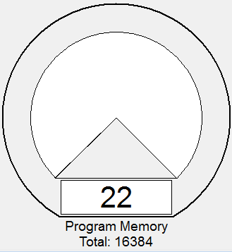
Example – Delay Program in Lab 1
Memory Usage Gauge

Slide 4
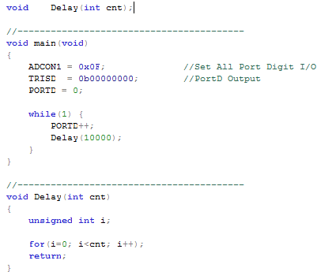
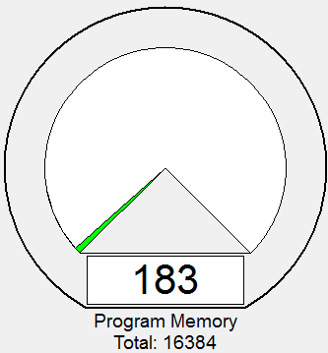
Same Program Coded in C
Memory Usage Gauge

Slide 5
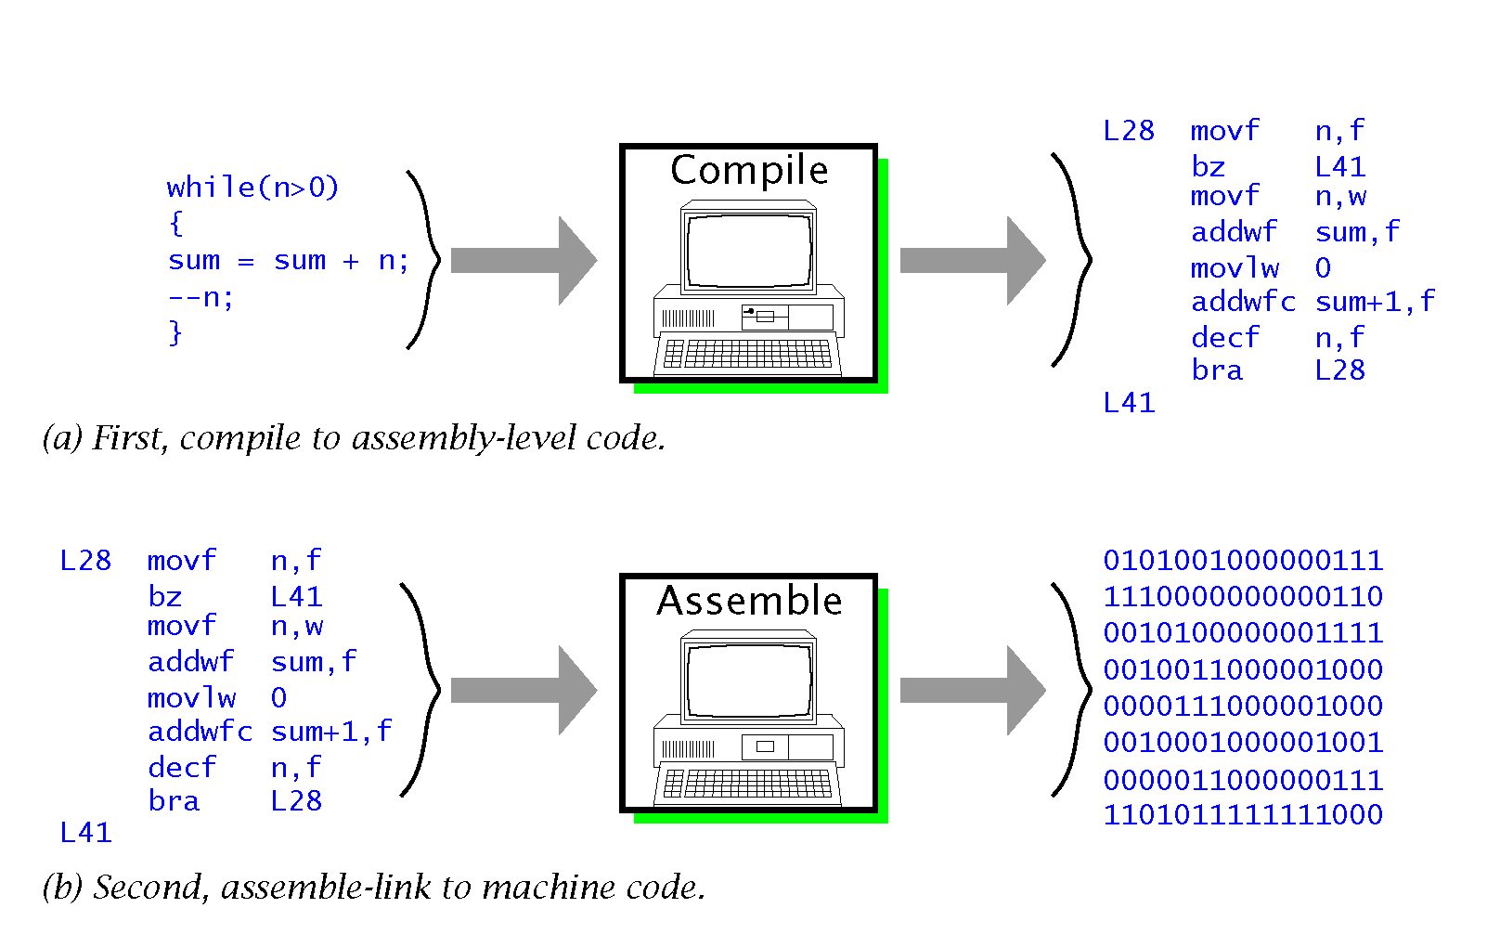
Disadvantages of C
The code produced is less space-efficient and runs more slowly than native assembly code.
A compiler is much more expensive than an assembler.
Image courtesy of S. Katzen, The essential
PIC18 Microcontroller, Springer
Notes:
In build assembly language program, we only need to assemble, that is converting assembly language to machine code. For C programming, we need an additional step, called compiling, which converts C code to assembly language code.

Slide 6
Data Types, Sizes and Ranges
Data Type | Size in Bits | Data Range
unsigned char | 8 | 0 to 255
(signed) char | 8 | -128 to +127
unsigned int | 16 | 0 to 65535
(signed) int | 16 | -32768 to 32767

Slide 7
Data Types, Sizes and Ranges
char
Because PIC18 is an 8-bit microcontroller, char data type is most commonly used.
C compliers use the signed type as default unless the qualifier unsigned is put in front.
int
int variables are stored in two 8-bit registers.
Don’t use int unless we have to. If one 8-bit register is enough to store a variable, we don’t want to use 2 registers.
Notes:
If one register is enough to store a variable

Slide 8
Use of C to generate time delay
Using assembly language, we can control the exact instructions executed in a time delay subroutine and thus be able to control the exact time delay.
DelayLoop: decfsz DELAY_L
bra DelayLoop
decfsz DELAY_H
bra DelayLoop

Slide 9
Use of C to generate time delay
C compliers convert C statements to assembly instructions.
Different compliers produce assembly code of different length.
The actual time delay generated by the following function depends on the complier used.
Need to measure the exact time delay using MPLAB StopWatch tool.
void Delay
{
unsigned int i;
for(i=0; i<10000; i++);
return;
}

Slide 10
I/O Programming in C
Recall: I/O Programming involves PORTx and TRISx registers.
Byte I/O Programming: Change the whole byte stored in PORTx or TRISx.
e.g., PORTB = 0x18
TRISB = 0X20

Slide 11
I/O Programming in C

Slide 12
I/O Programming in C
Bit-addressable I/O programming: Change a single bit without disturbing the rest of the PORTx or TRISx registers.
PORTBbits.RB7 = 7th bit of PORTB
TRISBbits.TRISB7 = 7th bit of TRISB
Same function as bcf or bsf in assembly language
e.g., bcf PORTB, 5 is expressed as PORTBbits.RB5 = 0 in C
e.g., bcf TRISB, 5 is expressed as TRISBbits.TRISB5 = 0 in C

Slide 13
Logic Operations in C
Bit-wise operators:
AND (&)
Extract lower nibble: PORTB & 0x0F
OR (|)
e.g., SPI_VALUE = 0x30 | SPI_HI
Exclusive OR (^): 1^1 = 0
Inverter (~)
e.g., Toggle PORTB: PORTB = ~PORTB

Slide 14
if statement: Conditional branching
if (CONDITION) {
Statement
}
CONDITION: The condition in which statement would be executed (if 1, execute statement; if 0, skip statement)

Slide 15
for loop
for(INITIALIZATION; CONDITION; INC/DEC){
Statement
}
INITIALIZATION: Initialize the “COUNT” variable
CONDITION: The condition in which this loop will continue (if 1, continue; if 0, exit)
INC/DEC: Increment/decrement the “COUNT” variable
Used when you know how many times the loop should run
An example :
//Using for loops to add numbers 1 - 5
unsigned char sum = 0;
for(int i = 1; i<6; i++)
{ sum += i; }

Slide 16
while loop
while(CONDITION){
Statement
}
CONDITION: The condition in which this loop will continue (if 1, continue; if 0, exit)
Used when you DO NOT know how many times the loop should run or if the loop should run infinitely many times (use while(1)).

Slide 17
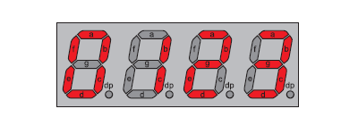
Simplicity of C: An Example
Lab 2 Task 2
Task: Display your group number of the 4-digit 7-segment LED.
Remember how much work you have done to make it work in assembly?
Very simple coding in C.

Slide 18
Simplicity of C: An Example
void Delay(unsigned int cnt)
{
while(cnt != 0) {
cnt--;
}
}
void main(void)
{
unsigned char Segment[10] = {0x3f, 0x06, 0x5b, 0x4f, 0x66, 0x6d, 0x7d, 0x07, 0x7f, 0x6f};
unsigned char DispBuf[4] = {0, 0, 1, 8};
unsigned char i;
ADCON1 = 0x0f; //Set All Port Digit I/O
TRISB = 0b00000000; //Set PortB Output
TRISD = 0b00000000; //Set PortD Output
while(1) {
for(i=0; i<=3; i++) {
PORTD = 0;
PORTB = i;
PORTD = Segment[DispBuf[i]];
Delay(400);
}
}
}

Slide 19
C18 Timers Library
C18 Timers Functions:
Function | Description
OpenTimerx() | Configure and enable timer x.
ReadTimerx() | Read the value of timer x.
WriteTimerx() | Write a value into timer x.
CloseTimerx() | Disable timer x.
To use the Timers library, simply put following statement before use
#include <timers.h>

Slide 20
Our interrupt program revisited
#include <p18F4520.h>
#include <timers.h>
#pragma config OSC = HS, WDT = OFF, LVP = OFF
void timer_isr_internal(void);
//----------------------------------------------------------------------------
#pragma code timer_isr = 0x08 // Store the below code at address 0x08
void timer_isr(void)
{
_asm GOTO timer_isr_internal _endasm // allowed to write part of your code in ASM.
}
//----------------------------------------------------------------------------
#pragma code
void main (void)
{
TRISBbits.RB5 = 0; //set RB5 output
PORTBbits.RB5 = 0;
//T0CON = 0x08; // Timer0, 16-bit, no prescale, internal ck
//TMR0H = 0xD8;
//TMR0L = 0xF0;
WriteTimer0(0xD8F0);
RCONbits.IPEN = 0; //disable priority levels
INTCONbits.TMR0IF = 0;
//INTCONbits.TMR0IE = 1; // Interrupt enabled by the TIMER_INT_ON option in OpenTimer0
INTCONbits.GIE = 1;
OpenTimer0(TIMER_INT_ON & T0_16BIT & T0_SOURCE_INT & T0_PS_1_1); //T0CONbits.TMR0ON = 1;
while(1);
}

Slide 21
Our interrupt program revisited
#pragma interrupt timer_isr_internal
void timer_isr_internal (void)
{
if (INTCONbits.TMR0IF)
{
INTCONbits.TMR0IF=0;
PORTBbits.RB5 = ~PORTBbits.RB5;//toggle PortB.5 to create sq. wave
//TMR0H = 0xD8;
//TMR0L = 0xF0;
WriteTimer0(0xD8F0);
}
}

Slide 22
interrupt, interruptlow
#pragma interrupt fname
retfie 1 ends the ISR.
WREG, BSR and STATUS registers are restored from the shadow registers.
#pragma interruptlow fname
retfie ends the ISR.
WREG, BSR and STATUS registers are restored from temporary registers.

Slide 23
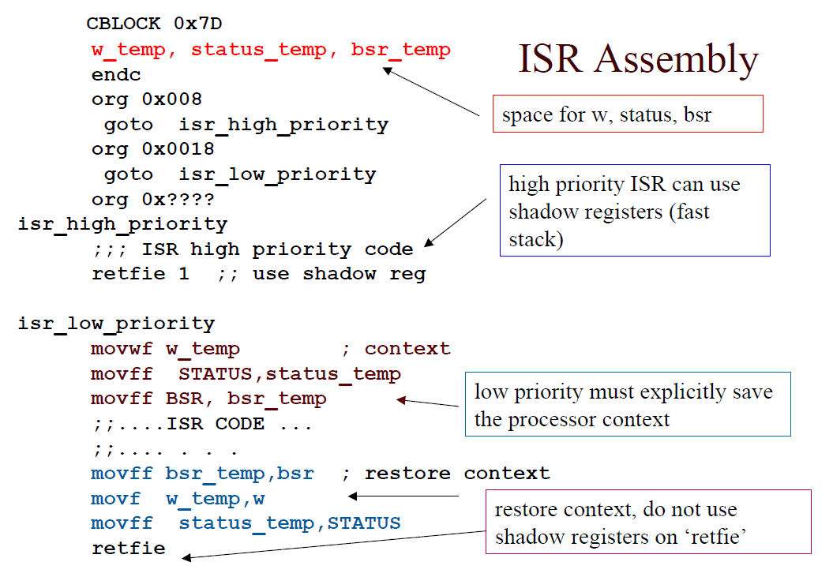
Just like in assembly language

Slide 24
C18 ADC Library
C18 ADC Library Functions:
Function | Description
OpenADC() | Configure the A/D convertor.
SetChanADC() | Select A/D channel to be used.
ConvertADC() | Start an A/D conversion.
BusyADC() | Is A/D converter currently performing a conversion?
ReadADC() | Read the results of an A/D conversion.
CloseADC() | Disable the A/D converter.
To use the Timers library, simply put following statement before use
#include <adc.h>

Slide 25
ADC Example in Assembly
Main: movlw b'00001110' movwf ADCON1 movlw b'00000001' movwf ADCON0 movlw b'00010100' movwf ADCON2 clrf TRISD MainLoop: bsf ADCON0, GO adc_wait: btfsc ADCON0, GO bra adc_wait movff ADRESH, PORTD bra MainLoop | ;Set AN0 Analog Port, others Digital I/O ;Select ADC Channel 0, Enable ADC ; ADFM Left justified, ACQT 4TAD, FOSC/4 ; set PORTD output ; start Conversion ; adc_wait waits for ADC to be done ;display Top 8 bit

Slide 26
Equivalent Operation in C
#include <p18f4520.h>
#include <adc.h>
#pragma config OSC=HS, WDT=OFF, LVP=OFF
void main( void )
{
static int result;
TRISD = 0x00;
OpenADC(ADC_LEFT_JUST & ADC_FOSC_4 & ADC_4_TAD,
ADC_CH0 & ADC_REF_VDD_VSS & ADC_INT_OFF,
ADC_1ANA);
while(1)
{
ConvertADC(); // Start conversion
while(BusyADC()); // Wait for completion
result = ReadADC();
PORTD = result >> 8;
}
}

Slide 27
I²C Functions
Function | Description
EEByteWrite | Write a single byte.
EEPageWrite | Write a string of data.
EERandomRead | Read a single byte from an arbitrary address.
EESequentialRead | Read a string of data.
EEAckPolling | Generate acknowledgement polling sequence: Send the control byte repeatedly to test whether the EEPROM has completed the internal reading cycle.

Slide 28
I²C Example
#include <p18F4520.h>
#include <i2c.h>
#pragma config OSC = HS, WDT = OFF, LVP = OFF
#pragma code
void main (void)
{
unsigned char i, WordAddress;
unsigned char DigitsToI2C[4] = {1, 2, 3, 4};
unsigned char DigitsReadFromI2C[4];
unsigned int DigitsToI2Cint;
unsigned char err;
ADCON1 = 0x0F;
//TRISCbits.RC3 = TRISCbits.RC4 = 1; Done in OpenI2C
OpenI2C(MASTER, SLEW_OFF);
SSPADD = 0x09;

Slide 29
I²C Example
WordAddress = 0;
// Byte Write:
for (i = 0; i < 4; i++)
{
EEByteWrite(0xA0, WordAddress, DigitsToI2C[i]);
WordAddress++;
EEAckPolling(0xA0);
}
WordAddress = 0;
// Byte Read:
for (i = 0; i < 4; i++)
{
DigitsToI2Cint = EERandomRead(0xA0, WordAddress);
//This function return a 16-bit int. The byte read is stored in the LSB.
DigitsToI2C[i] = DigitsToI2Cint & 0x00FF;
WordAddress++;
}

Slide 30
I²C Example
//Page Write:
EEPageWrite(0xA0, 0x00, DigitsToI2C);
EEAckPolling(0xA0);
// Sequential Read:
EESequentialRead(0xA0, 0x00, DigitsReadFromI2C, 4);
}

